Slide 1
REAL-TIME ELECTRICITY CONSUMPTION MONITORING SYSTEM
(IoT Based Smart Energy Monitoring System)
DHANASEKARAN E - 922222104009
HARISHBABU H - 922222104014
JAIGANESH R - 922222104018
Guide: Mr.D.Rajapandi
Team Members,

Slide 2
ABSTRACT
The Real-Time Electricity Consumption Monitoring System is an IoT-based smart energy monitoring solution designed to continuously measure and analyze electrical power usage. The system uses current and voltage sensors connected with an ESP32 microcontroller to collect real-time electrical parameters such as voltage, current, power, and energy consumption. The collected data is processed and transmitted to the ThingSpeak cloud platform through Wi-Fi for live monitoring and visualization. The system helps users track electricity usage efficiently, detect overload conditions, reduce energy wastage, and improve power management. This project provides a low-cost, scalable, and efficient solution for smart homes, industries, and energy management applications.

Slide 3
INTRODUCTION
Electricity consumption is increasing rapidly due to the growth of industries, smart homes, and modern electrical appliances. Efficient energy management has become an important requirement for reducing electricity wastage and improving power utilization. Traditional electricity monitoring systems provide only periodic readings and do not support real-time monitoring or remote access. This makes it difficult for users to analyze power consumption, detect overload conditions, and optimize energy usage effectively. This project enables remote monitoring, graphical visualization, and efficient energy management using cloud technology.

Slide 4
EXISTING SYSTEM
• Traditional electricity meters provide only periodic readings.
• No cloud integration or remote monitoring features.
• Difficult to identify overload and abnormal consumption.
• Manual monitoring causes delays in energy analysis.
• No graphical visualization of electricity consumption.
• Lack of real-time fault detection.

Slide 5
DISADVANTAGES OF EXISTING SYSTEM
• Increased electricity wastage.
• Delayed identification of faults and overload conditions.
• No remote monitoring capability.
• Poor energy management efficiency.
• Lack of accurate real-time data visualization.
• Manual monitoring process increases complexity.

Slide 6
PROPOSED SYSTEM
• IoT-based electricity monitoring system using ESP32.
• Real-time measurement of voltage, current, power, and energy.
• Wireless communication through Wi-Fi.
• ThingSpeak cloud integration for graphical visualization.
• Remote access to electricity consumption data.
• Automatic and continuous monitoring system.

Slide 7
ADVANTAGES OF PROPOSED SYSTEM
• Real-time electricity monitoring.
• Cloud-based remote access.
• Accurate measurement of electrical parameters.
• Early detection of overload conditions.
• Reduced electricity wastage.
• Low-cost and scalable implementation.
• Better energy management and analysis.

Slide 8
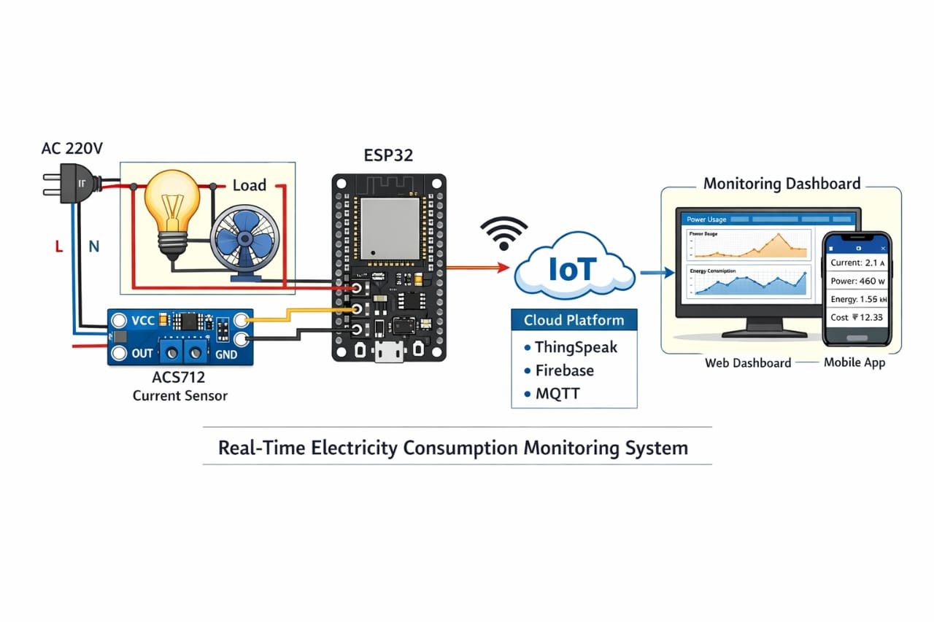
BLOCK DIAGRAM

Slide 9
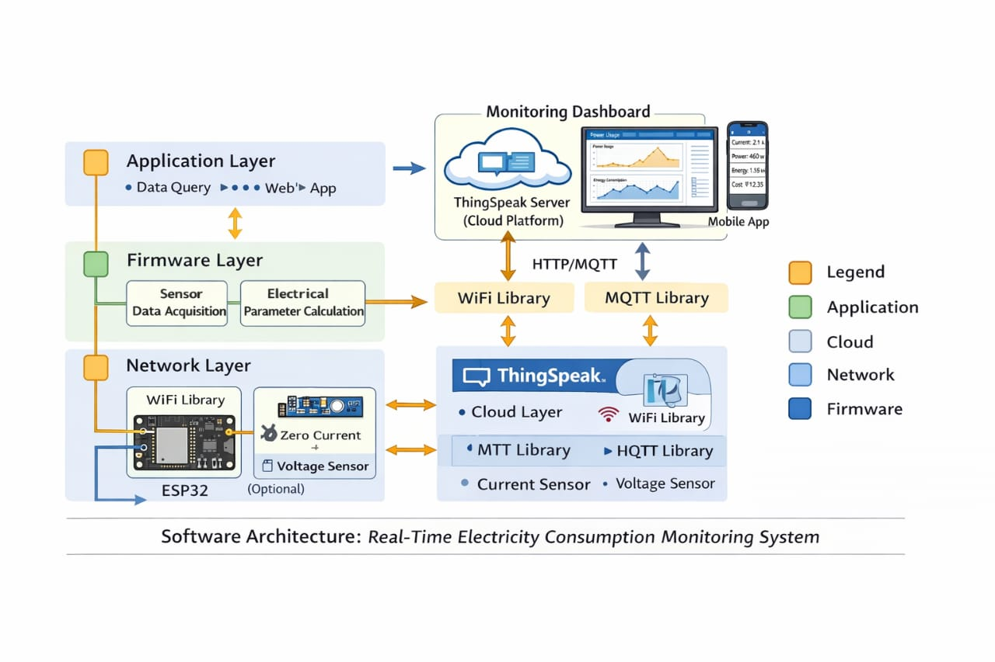
SYSTEM ARCHITECTURE

Slide 10
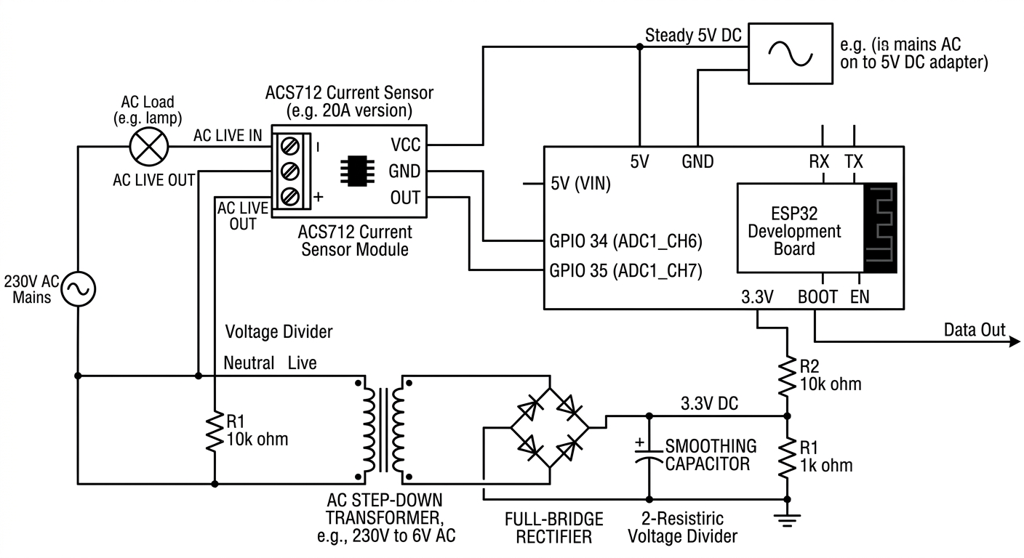
CIRCUIT DIAGRAM

Slide 11
HARDWARE REQUIREMENTS
• ESP32 Development Board
• ACS712 Current Sensor
• Voltage Sensor
• Resistors and Capacitors
• Wi-Fi Communication Module
• Breadboard and Connecting Wires

Slide 12
SOFTWARE REQUIREMENTS
• Arduino IDE
• C ++
• ThingSpeak Cloud Platform
• HTML, CSS, JavaScript
• HTTP Client Library
• ESP32 Board Package
• Serial Monitor for Debugging

Slide 13
WORKFLOW OF THE SYSTEM
Voltage & Current Sensing
↓
Signal Processing using ESP32
↓
Power and Energy Calculation
↓
Wi-Fi Data Transmission
↓
ThingSpeak Cloud Storage
↓
Real-Time Monitoring and Visualization

Slide 14
IMPLEMENTATION
• Hardware components were assembled and connected successfully.
• Sensors continuously monitor electrical parameters.
• ESP32 calculates voltage, current, and power values.
• Wi-Fi communication transmits data to cloud platform.
• ThingSpeak dashboard visualizes real-time readings.
• The system was tested under different electrical loads.

Slide 15
Modules
• Thingspeak Cloud Integration
Arduino Programming
• Web Dash Board Creation
• Data Visualization

Slide 16
THINGSPEAK CLOUD INTEGRATION
• ThingSpeak platform is used for cloud-based monitoring.
• ESP32 uploads real-time sensor data through Wi-Fi.
• Voltage, current, and power readings are visualized as graphs.
• Data can be monitored remotely from any location.
• Cloud storage helps in future analysis and tracking.

Slide 17
ARDUINO PROGRAMMING
• Arduino IDE was used to develop and upload the program to the ESP32 microcontroller.
• Electrical parameters such as voltage, current, power, and energy consumption are calculated using embedded logic.
• Wi-Fi communication libraries were used to establish connection with the ThingSpeak cloud platform.
• Sensor data is transmitted periodically for real-time monitoring and analysis.
• The program also handles error detection and stable cloud communication.

Slide 18
WEB DASHBOARD CREATION
• A web dashboard was created to display real-time electricity monitoring data.
• HTML, CSS, and JavaScript were used to design the user interface.
• The dashboard displays voltage, current, power, and energy readings dynamically.
• ThingSpeak cloud API was integrated to fetch and visualize live sensor data.
• Graphical representation improves user understanding and energy analysis.

Slide 19
DATA VISUALIZATION
• Real-time sensor data is visualized using ThingSpeak graphical charts.
• Voltage, current, and power values are displayed continuously.
• Cloud-based visualization helps users analyze energy consumption patterns.
• Graphs improve monitoring efficiency and simplify energy management.
• Visualization helps identify abnormal power usage and overload conditions.

Slide 20
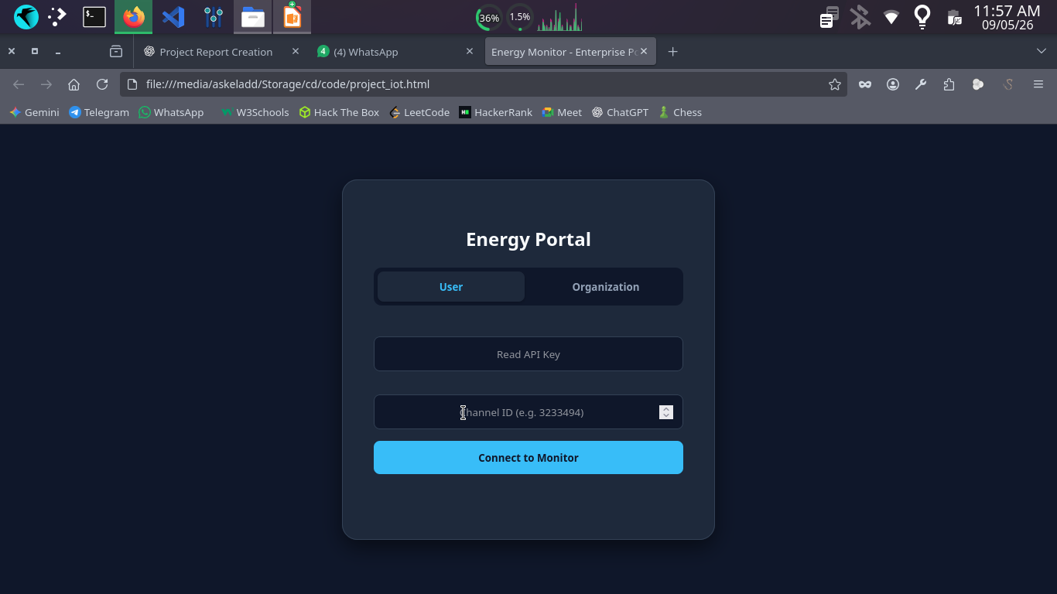
User Login

Slide 21
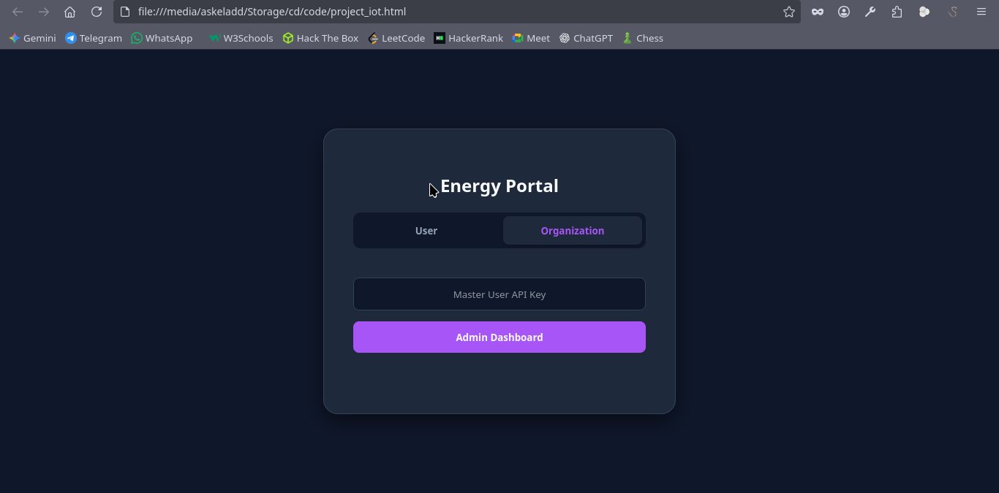
Organization Login

Slide 22
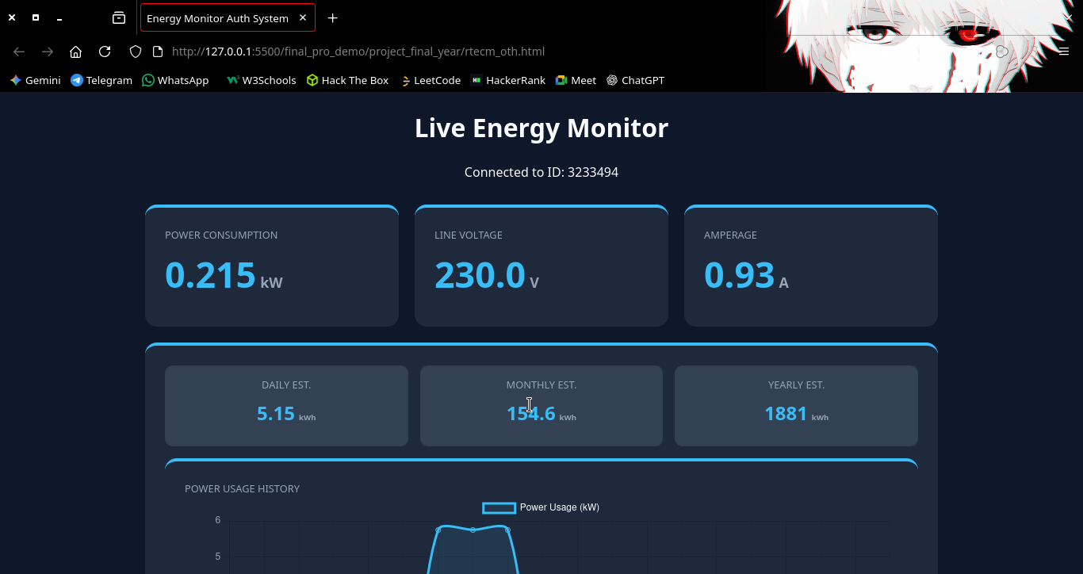
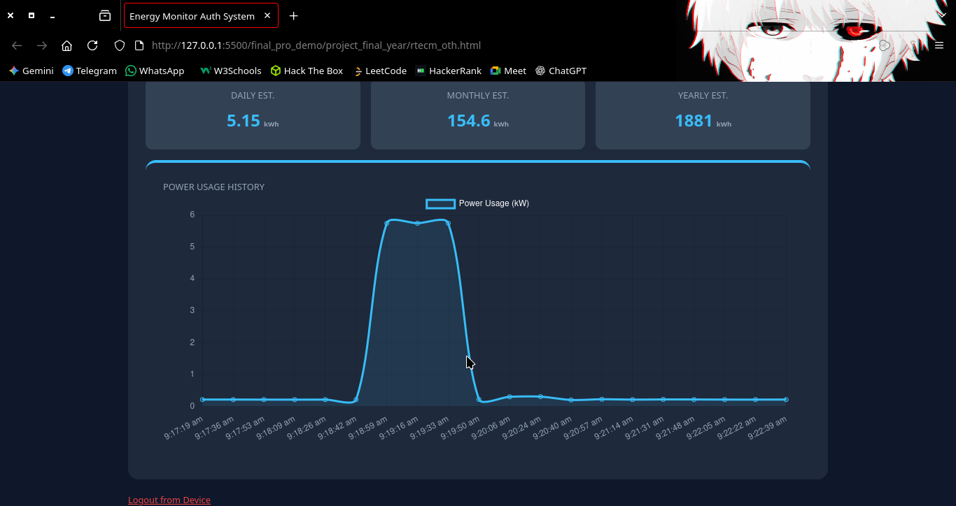
Web DashBoard

Slide 23
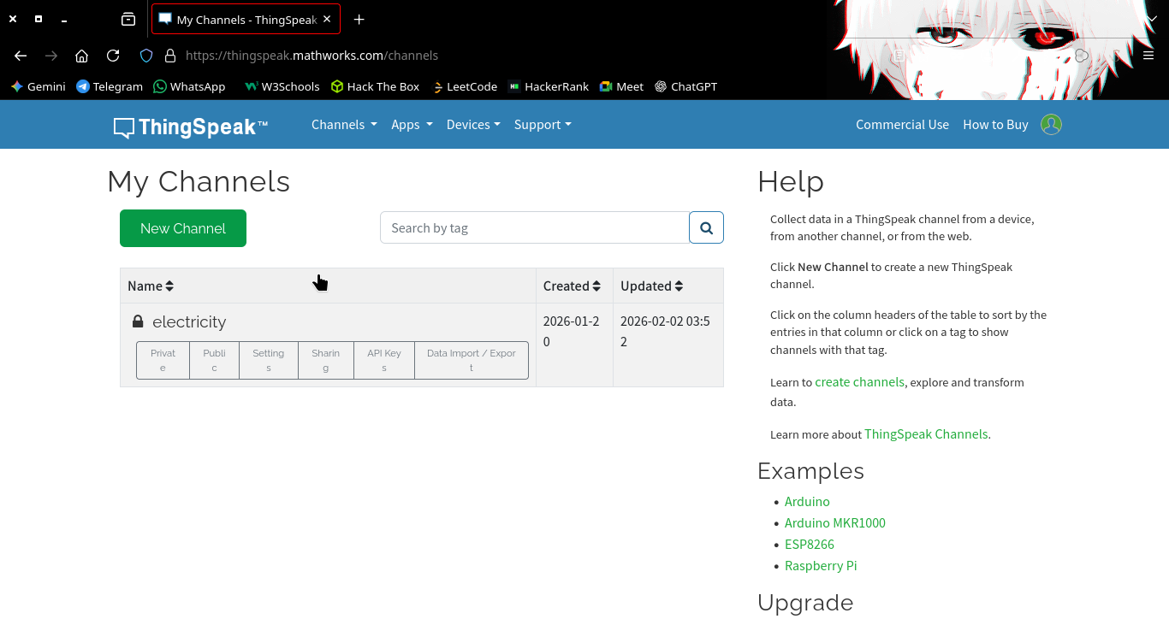
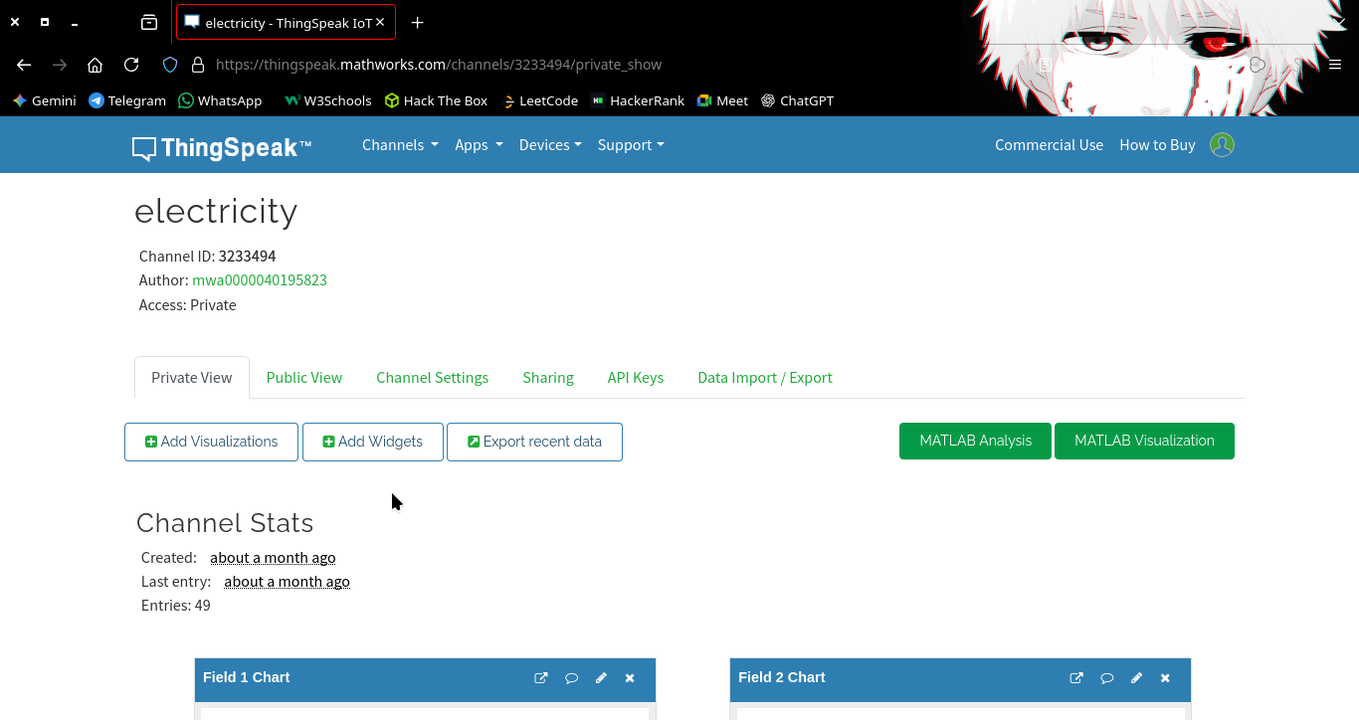
Thingspeak DashBoard

Slide 24
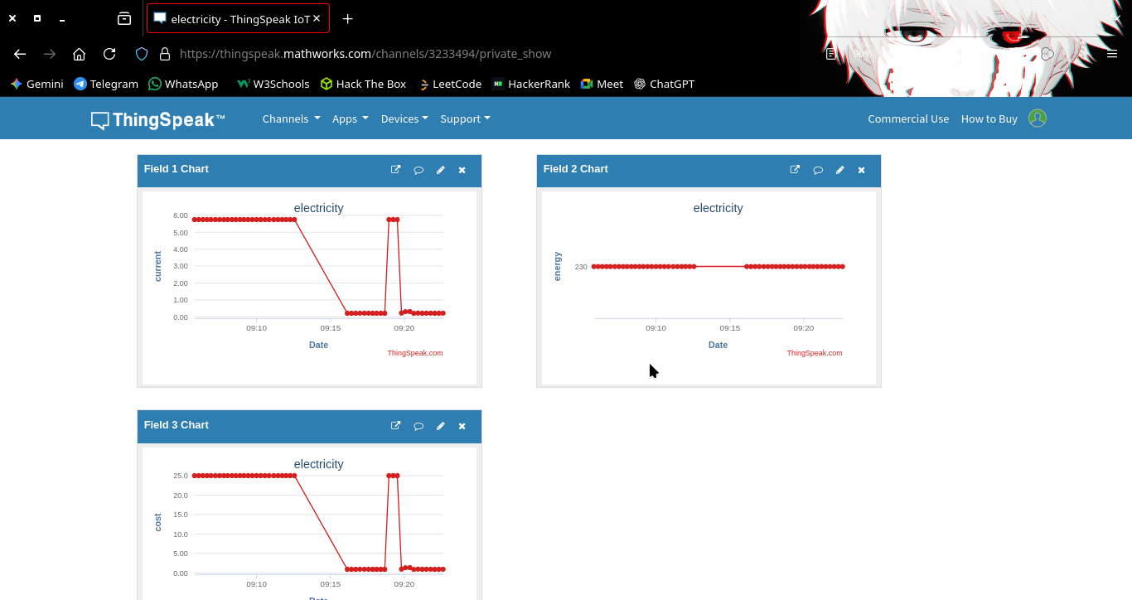
Data Visualization

Slide 25
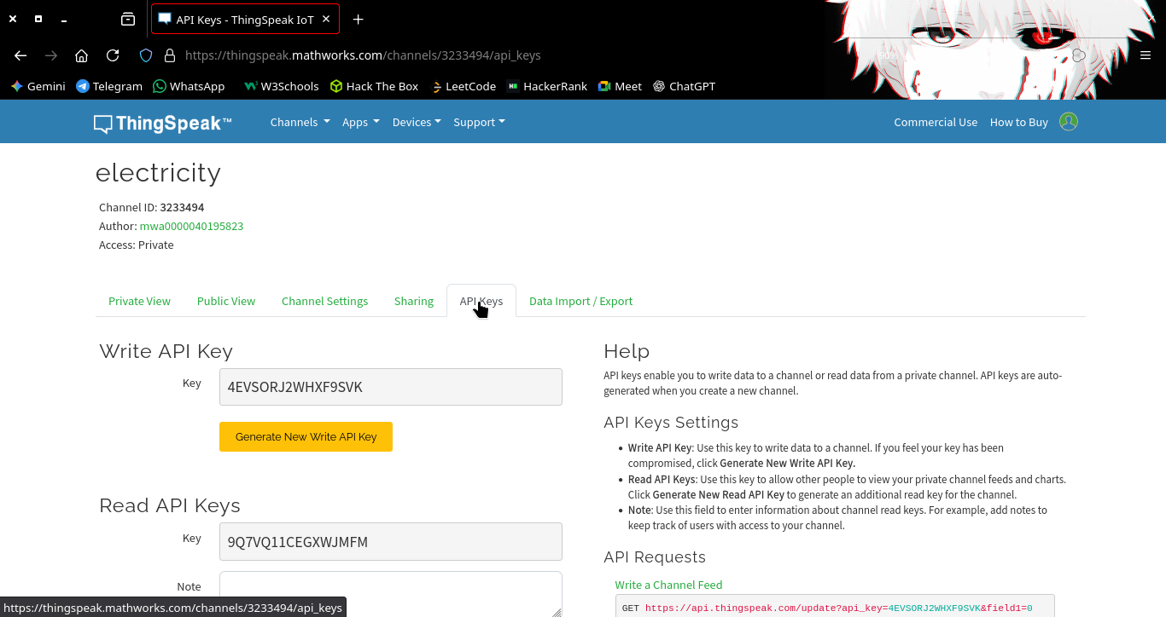
API Integration

Slide 26
RESULTS AND ANALYSIS
• The system successfully monitored electricity consumption in real time.
• Voltage and current readings were transmitted accurately.
• Graphical visualization was generated using ThingSpeak.
• Real-time monitoring reduced manual monitoring complexity.
• The system effectively identified power usage variations.
• Stable communication was achieved using ESP32 Wi-Fi module.

Slide 27
CONCLUSION
The Real-Time Electricity Consumption Monitoring System successfully provides accurate and continuous monitoring of electrical energy usage using IoT technology. The integration of ESP32, sensors, and ThingSpeak cloud platform enables remote monitoring, graphical analysis, and efficient energy management. The project is scalable, cost-effective, and suitable for smart homes, industries, and energy monitoring applications. The project demonstrates how IoT technology can be effectively used for smart energy monitoring and future smart grid applications.

